Slide 1
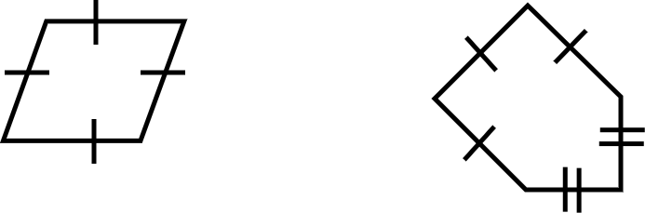
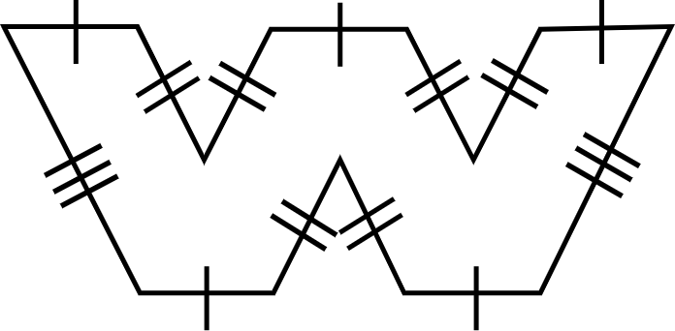
Calculating missing lengths with perimeter of polygons
Task A: Calculating unknown lengths
1) Calculate the lengths of the marked sides.
a) b)
c)
7 units
b
a
Perimeter = 10 units Perimeter = 25 units
c
9 m
4 m
Perimeter = 74 m

Slide 2
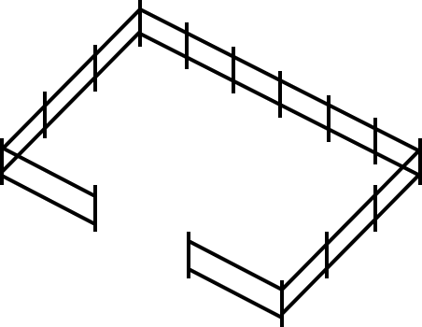
Calculating missing lengths with perimeter of polygons
Task B: Problems in context
1) Write your own problem using the same measures but in a different context.
Length = 90 m
Width = 45 m
Perimeter = 195 m
Mathematics in Education and Industry.

